Slide 1
HOOD Requirements Definition Process
http://www.hood-group.com/en/home/

Slide 2
HOOD Process from ‘Requirements Management’ Springer 2007, Colin Hood et al
Initiate
Identify Interfaces
Define Interfaces
Define Stakeholders and Roles
Scope
Modelling
Elicitation
Specification
Analyse
Review
Definition
Derive Requirements

Slide 3
Scope
We need to decide what is inside the system and what is outside the system
What activities are part of this process?
  Identify Interfaces
  Define Interfaces
  Define Stakeholders and Roles

Slide 4
Identifying Interfaces
You need to interview your customer (and later your stakeholders) to establish what the boundaries are.
For example…an online system has to be developed to help students in their final year pick a project title.
On initial discussions with the customer (Coordinator for final year projects) it appears that there are several aspects to the problem.

Slide 5
Final Year Projects Problem
Propose Projects
Final Year Projects
Select Projects
Allocate Supervisor

Slide 6
Proposing a Project
External
Submit Proposal
Staff
<<extends>>
Negotiate Proposal
Student
Coordinator

Slide 7
Allocate Supervisor
Identify Supervisors
Staff
Match Supervisors to students
Student
HOS

Slide 8
Scope
Identify Supervisors
Staff
Match Supervisors to students
Student
HOS
External
Submit Proposal
Staff
<<extends>>
Negotiate Proposal
Coordinator
Student

Slide 9
Defining the Interfaces
We have identified interfaces between the system of interest to us and the ‘others’ of no interest to us.
Defining the interface would involve describing the dialogue that goes on between us and them
We can see already that we need to interface with the HOS
A description of this might be provided in a number of ways
  Plain narrative
  Boundary (interface) class in a class diagram
  Use Case Text

Slide 10
Use Case: Match Supervisors to Students
Trigger: Complete set of proposals are available.
Execute matching algorithm
Inform Student of supervisor
Inform Supervisor of Students
Inform HOS of allocation
Termination: All students are allocated a supervisor-project

Slide 11
Class Diagram
Allocate
Allocation List:(Student,Supervisor, Proposal)
Perform Matching algorithm
<<interface>>
Inform
Contact Details
Inform Student
Inform Supervisor
Inform HOS

Slide 12
Define Stakeholders and Roles
Task | Role | Stakeholder
Negotiate a proposal | Proposer Approver | Student Coordinator External Company HOS
Communicate Allocation | Coordination | Staff Student HOS Coordinator
Calculate Allocation | Calculator | Coordinator Course Director

Slide 13
Definition of Requirements
Elicitation
Collect requirements from stakeholders via fact finding techniques such as interview, observation, participation etc.
Collect requirements from existing specifications or other documentation
Use UML models to clarify your understanding with the stakeholders

Slide 14
Using UML Models
The stakeholders have suggested…
A supervisor must know of the allocation before the student.
A student must contact the supervisor within 48 hours
A supervisor must be a member of academic staff
Staff
Student
Supervisor
System
One Hour Max
48 Hours Max
Supervisor

Slide 15
Using UML Models
A stakeholder has described…
The allocation must match students to proposals on the basis of performance
Obtain next student
Read Next Choice
Another student
Choice taken
Another choice
Allocate to Supervisor
To do list

Slide 16
Communicating Requirements
The use of the diagrams helps us to clarify our understanding of the requirements elicited from the stakeholders.
Of course in some cases the diagrams may not be understood by stakeholders when the picture becomes complicated
In this way, a stakeholder may agree that a diagram accurately represents an understanding of a requirement only for the engineer to find out later that it does not
There is no easy solution to this problem!

Slide 17
Specification
We specify requirements in order to convey requirements to others.
Stakeholders are important receivers of requirements statements but so are designers and engineers who will turn the requirements into working solutions.
A Requirements specification includes a list of uniquely identifiable and atomic requirements
The UML diagrams are important clarifiers of these specified requirements
Requirements specification should include these UML diagrams where necessary for clarification
Volere Requirements Templates provide a useful basis for specifying requirements

Slide 18
Analysis
Study, examine, investigate and scrutinise every requirement.
Reach an understanding of the requirements with all parties.
Consider if the requirements, as specified, are likely to lead to a system which will satisfy the users in their own environment (Validation)

Slide 19
Reviews
Check that the specified requirements conform to the quality criteria (PPQA)
  Atomic
  Identifiable
  Understandable
  Unambiguous
  Testable
  Realisable
  Non-redundant
  Consistent
  Traceable
  Complete
Doing it
Capable
HOOD Capability Levels
Expert

Slide 20
Mapping the HOOD Process to CMMI
RD
SG1 Develop customer requirements
SP1.1 Elicit needs
SP1.2 Develop the customer requirements
SG2 Develop product requirements
SP2.1 Establish product and product component requirements
SP2.2Allocate product component requirements
SP2.3Identify interface requirements
SG3 Analyse and validate requirements
SP3.1 Establish operational concepts and scenarios
SP3.2 Establish a definition of required functionality
SP3.3 Analyse requirements
SP3.4 Analyse requirements to achieve balance
SP3.5 Validate requirements
HOOD
Scope is defined through:
Identifying interfaces
Defining interfaces
Defining stakeholders and roles
Requirements are defined by
Elicitation
Specification
Analysis
Review
PPQA

Slide 21
Requirements Management
REQM is the sum of all activities which take place after requirements have been specified (during RD) that are necessary to keep the value of requirements at a high level
In other words, without carrying certain activities, the requirements specification becomes less and less valuable/meaningful over time
So what might these activities be…
  Obtain understanding of requirements
  Obtain commitment to requirements
  Manage requirements changes
  Maintain bi-directional traceability of requirements
  Identify inconsistencies between project work and requirements

Slide 22
Lets consider some simple requirements
The machine must produce steel rods at 500 per hour
The machine must have an emergency switch
The emergency switch must stop the machine within 5 seconds
The machine must cut the steel rods to a length of 60mm ± 1.5mm

Slide 23
During RD we are concerned with understanding what the customer wants and clarifying and representing this in a specification of requirements
Knowing that a requirement will be too expensive or whether it makes sense may not be evident during RD.

Slide 24
Consider some post specification issues
Can the requirement be realised at all
  It maybe the case that for technical reasons no such machine can produce 500 rods per hour to the tolerances specified
The stakeholder may want to change a requirement.
  It may be that the rods now need to be cut to within ± 1.0mm
  What should happen to this new ‘change request’?
  If we evaluate it and find that it is not feasible, what should we do with this information?
  If it is feasible we must decide if we will implement it or not.
  What decision criteria will we use? Have we considered the decision criteria prior to the project?

Slide 25
Lets assume that we decide to implement the new requirement
How do we document the change to the new requirement?
Do we delete the old requirement and replace it with the new one? If so how can we tell there has ever been another set of requirements? Why would we need to know if there were other original requirements?
Do we document the reason for our decision?
If we go ahead we might find out later that the implementation breaks another requirement about power consumption of tools. Why were we not aware of this? How could this have been overlooked?
Assume that the project budget only allows implementation of three of the four requirements. How do we know this? Who do we tell? When did we find out? Could we have found out earlier? Are there ay advantages to knowing this earlier? Does it make sense to proceed now that we know this?
If we proceed which requirement will we eliminate? How do we make the decision? Do we ask someone? Who? Why?
Are the acceptance tests still valid? How, when and by whom should the tests be carried out? Do we need to consult these people? What happens if tests fail? Do we know about the risks associated with unsuccessful tests?

Slide 26
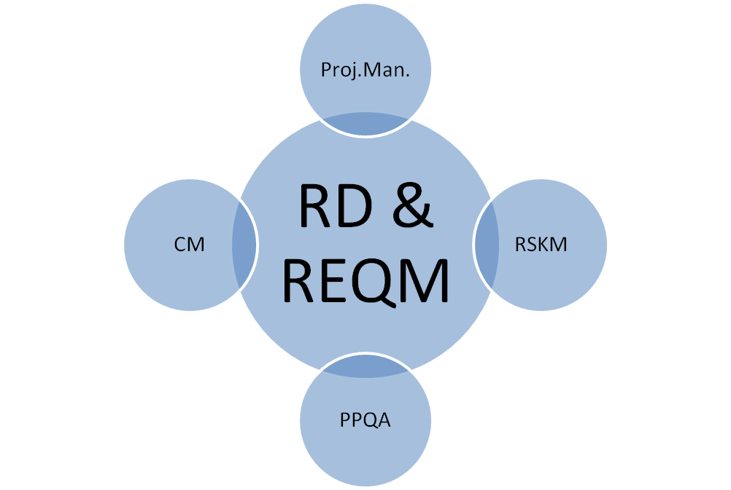
Disciplines with important links to REQM and RD

Slide 27
RD Vs REQM
Requirements Development assures that what is to be developed is indeed what the customer wants.
Requirements Management integrates the data created during requirements development into the overall project flow.
The purpose of the last few slides is to illustrate that if this information is not integrated with other project activities, many questions will arise and remain unanswered after the requirements have been specified. The result is that the value/quality/meaning of the requirements will lessen
Documentation costs very little at the time, but is worth so very much for making changes in the future
Reusability is important for some industries to stay competitive (e.g. automotive industries)
Reusability of requirements is key
REQM demands that all relevant information is documented and retrievable

Slide 28
Communication
REQM tries to make sure that everybody has all the background knowledge they need and that information is flowing properly between all parties
It is optimum communication which reduces lifecycle time and hence cost

Slide 29
Traceability
Requirements should be linked to their acceptance tests
Requirements on each level of abstraction should also be linked to the requirements on the level above
  For example all derived requirements must have a link to the customer requirements and all product requirements must have a link to the customer requirements
Traceability of requirements involves linking requirements with the work products of other process areas such as project management, technical solution, risk management and so on.
Traceability is the responsibility of a Requirements Management Process

Slide 30
Traceability
Often, the real rationale for a particular design and the deeper understanding of how the components of a system work together to achieve an end result remain in the minds of the engineers. Months or years later, when the original designers have long since moved on, or their memory has dimmed, the loss of that under­standing may seriously impede the ability to evolve, maintain or reuse the system.
Traceability is a technique for maintaining this greater understanding of a system, through capturing the rationale associated with the relationships between problem, solution and design.

Slide 31
Elementary Traceability
There are many ways of representing many-to-many relationships. One consultant visited a defence contractor just prior to a customer traceability audit to find the office all laid out ready. Along the length of the floor on one side was spread out the requirements document and on the other side the code listing. Traceability was shown by pieces of string taped between the documents. Space con­suming, time consuming, non-maintainable and non-transportable. But it did some of the job.
Many engineers will have seen traceability represented in matrix form as an appendix to relevant documents. The two dimensions identify, for instance, user requirements on one axis and system requirements on the other, with marks in those cells where a relationship exists.

Slide 32
Elementary Traceability
There are a number of disadvantages to this approach:
Where there are a large number of statements to index on both axes, the paper or screen is too small to show enough information.
Traceability relationships tend to be sparse, resulting in most of the cells in the matrix being empty, which is a waste of space.
It is very hard working your way through multiple layers of traceability presented in a number of separate matrices.
Information about traceability is separated from the details of the requirments themselves.

Slide 33
Elementary Traceability
Another method is to use hyper-linked documents, where statements can be highlighted, linked to other statements and traversed at will - in either direction if you are clever. Now the traceability information is visible in the text of the statement, but there are still problems:
  To carry out analysis you may have physically to traverse the link before text at the other end is visible.
  It is hard to spot when the item at the other end of a hyperlink has been deleted, leaving a dangling link, making traceability difficult to maintain.

Slide 34
Elementary Traceability
Whatever approach you use, unless supported by a tool, traceability will b very hard to manage.
The simplest form of traceability is achieved by linking statements together using some kind of database support.
Elementary traceability represents a major step for most organisations.

Slide 35
Essential capabilities for implementation of traceability are:
ability to create links between statements, thus forming permitted relationships;
ability to delete links between statements in a controlled manner;
ability to view simultaneously the text (or other attributes) of statements at both ends of a selected relationship;
ability to carry out coverage analysis to show those statements covered or not covered by a selected relationship;
ability to carry out single and multi-level impact analysis to show sets of impacted statements;
ability to carry out single-level and multi-level derivation analysis to show sets of originating statements;
ability to carry out upwards and downwards coverage analysis to show sets of statements covered and not covered by selected relationships.

Slide 36
Example of Elementary Traceability
PR 15: The vehicle shall transmit power to all four wheels
Elementary traceability asserts that somehow the Product Requirements are sufficient to implement the User Requirement. The three PRs play some kind of role in the satisfaction of UR21. It is difficult to assess this because Elementary Traceability neglects to include the reasoning.
UR 21: The driver will be able to deploy the vehicle over terrain type 4A
PR 32: The vehicle shall have ground clearance of more than 21 cm
PR 53: The vehicle shall weigh not more than 1.5 tonnes

Slide 37
Rich Traceability
Rich Traceability is a way to satisfy the satisfaction argument. This appears as another statement sitting between the user requirement and the corresponding product requirements.
Not only is the satisfaction argument expressed textually, but an indication IS given about the way in which the system requirements combine in the argument using a propositional operator
PR 15: The vehicle shall transmit power to all four wheels
UR 21: The driver will be able to deploy the vehicle over terrain type 4A
Terrain type 4A specifies soft wet mud, requiring constraints on weight, clearance and power delivery
&
PR 32: The vehicle shall have ground clearance of more than 21 cm
PR 53: The vehicle shall weigh not more than 1.5 tonnes

Slide 38
Conjunction - Disjunction
by conjunction (&), indicating that the contribution of all the product requirements is necessary for the user requirement satisfaction argument to hold:
by disjunction (or), indicating that the contribution of any one of the product requirements is necessary for the user requirement satisfaction argument
to hold.
Much more information is now provided about how the user requirements are being satisfied. Even one who is not a domain expert may feel capable of assessing important aspects of the argument. The text helps in assessing the lope of the argument for validity and completeness. The operator makes the structure of the argument more precise.

Slide 39
Conjunction - Disjunction
Notice in particular that it is not at all clear in that the set of system requirements represent alternative solutions, whereas in this example the fact IS made absolutely specific.
If an electric ring cannot be supplied, the requirement can still be satisfied through a gas ring.
PR37: The cooker shall have a 3kW, 15 cm diameter electric plate
UR 3: The user shall be able to boil 10 litres of water in 4 minutes in a flat bottomed pan
Two kinds of flat plates can achieve this performance
OR
A large gas ring with medium pressure gas supply
PR31: The cooker shall have a 10 cm diameter gas ring
&
PR 41: The cooker shall be supplied with gas pressurised at not less than 25psi

Slide 40
Reviewing Traceability
Every requirement should be reviewed along with its satisfaction argument.
Analysis can also take place based on propositional structure. For example, the propositional structure for UR3 can be captured in the propositional logic expression
[PR37and (notPR31) and (notPR41)]
or [PR37 and PR31 and (not PR41)]
or [PR37 and (not PR31) and PR41]
or [PR37 and PR31 and PR41]
or [(not PR37) and PR31 and PR41]
imagine more complex scenarios where there are hundreds of requirements in several layers with complex interactions. One may want to know whether there is any way of meeting the requirements and, if there is no way, then what the cause is - where the conflict exists.
In other words we need the propositional logic expression to return ‘true’ in our solution if we are to meet the user requirement to boil 10 litres of water in 4 minutes in a flat bottomed pan. Easy to validate our product here because we can establish truth easily for each PR
The expression may return false. This would need to be analysed to establish the cause.

Slide 41
Of all the advantages of traceability it is the increase in confidence in meeting requirements that is so clearly addressed through rich traceability
There is considerable effort involved in the creation of complete satisfaction arguments, especially in complex systems with hundreds of requirements

